Slide 1

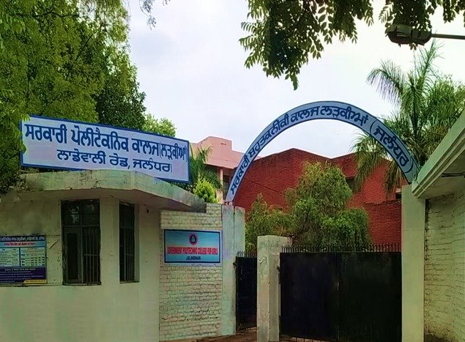
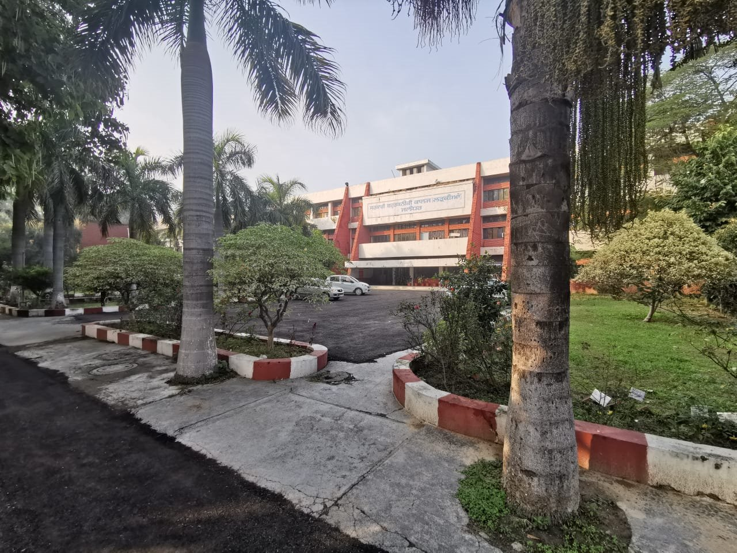




Govt. Polytechnic College, Jalandhar

Slide 2
Govt. Polytechnic College, Jalandhar
Government Polytechnic College, Jalandhar was established in 1970.
The college is approved by All India Council of Technical Education, New Delhi.
The campus is situated on Ladowali Road just 1 km from Bus stand Jalandhar and 1.5 Kms from Railway Station Jalandhar.
The institution has beautiful administrative block, hostel, staff colony, well maintained lawns and grounds spread over an area of 10 acres.
Best Polytechnic College Award in 2006

Slide 3


Govt. Polytechnic College, Jalandhar
“To develop the Institution as centre of excellence in field of technical education and to turn its dream into reality by imparting value based quality education to the students so that they become complete and confident individuals in order to face the stark realities of the highly competent world.”
“Our Mission is to instill in young students a hunger for excellence and moral obligation towards society. We wish to make them capable of keeping peace with the young India having World’s largest youth population, where young men and women are assuming greater responsibilities each day.”

Slide 4
Govt. Polytechnic College, Jalandhar
Message from Principal
“I strongly believe that the purpose of education is to create mature, sensible, tolerant and professionally equipped individuals. To me it’s a matter of pride that our faculty and management together are ensuring that students are provided the best of learning.”

Slide 5
Govt. Polytechnic College, Jalandhar
Faculty
We have well- qualified and incredibly diverse faculty who believes in innovation and uses modern methods of teaching.
All the faculty update their knowledge about latest topics through continuous preparation and faculty development programs.
All faculty well versed with use of latest pedagogy and interactive learning methods for formulating students for meeting modern industry requirement's.
Faculty’s main focus is on training of students to become thorough professionals who are responsible, knowledgeable, hardworking and team players.

Slide 6
Govt. Polytechnic College, Jalandhar
Diploma | Intake | Eligibility | Duration
Architecture Assistantship | 30 | Matriculation (Maths+Science+English) | 3 Years
Computer Engineering | 60 | Matriculation (Maths+Science+English) | 3 Years
Electronics & Communication Engineering | 60 | Matriculation (Maths+Science+English) | 3 Years
Information Technology | 30 | Matriculation (Maths+Science+English) | 3 Years
Library & Information Science | 30 | Matriculation (Maths+Science+English) | 3 Years
Modern Office Practice | 30 | 10+2 (Any Stream) | 3 Years
D. Pharmacy | 30 | 10+2 (Med./ Non Med.) | 2 Years
*Lateral Entry in 2nd Year Diploma for 10+2 (Science/Vocational) and ITI passed students.

Slide 7


Fee Structure & Various Scholarship Schemes
Chief Minister Scheme
Category | Percentage in Qualifying Exam | Fee without concession per year | Fee at the time of admission after concession | Fee payable after six months
General, OBC & Others | 60% to less than 70% | 29150 | 10450 | 3300
 | 70% to less than 80% | 29150 | 9350 | 2200
 | 80% to less than 90% | 29150 | 8250 | 1100
 | 90% and above | 29150 | 7150 | 0
(Contd.)

Slide 8

Scholarships
Post Matric Scholarship Scheme | Fee Waiver Scheme | Freeship Scheme
For students who belong to SC category having annual family income less than 2.5 lac Total fee= Rs.1133/-+ Board Registration Charges | Tuition fee is exempted to meritorious students of qualifying exam | Upto 100% tuition fee is exempted for semester exam toppers

Slide 9
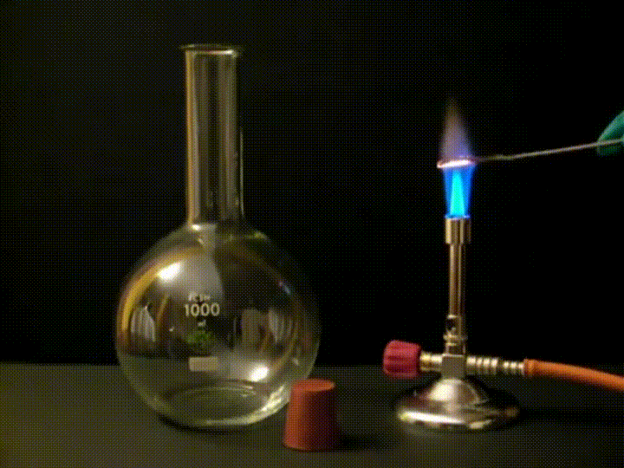
Govt. Polytechnic College, Jalandhar
Department of Applied Science
Basic Building block of Engineering
Inculcates the skills of critical
reasoning, problem solving and
communication
Lay strong foundation of basic
principles of various disciplines

Slide 10
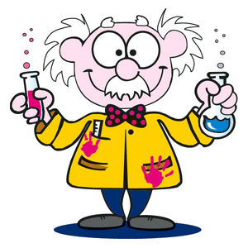

Department of Applied Science

Slide 11
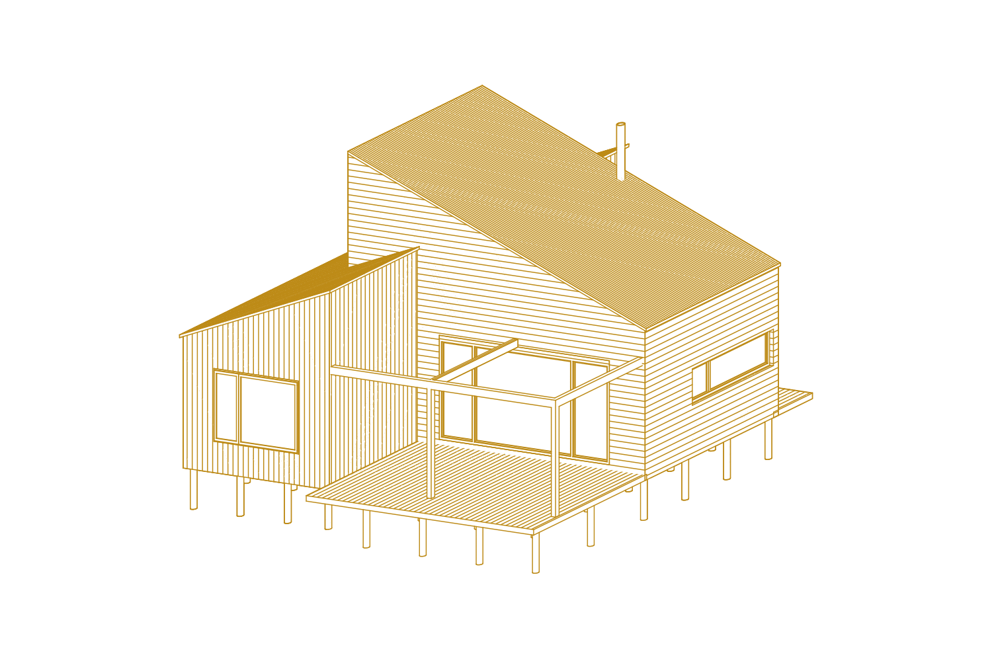
Govt. Polytechnic College, Jalandhar
Department of Architectural Assistantship
An Architect plans, designs and
review the construction of buildings.
Diploma holders are licensed by
local bodies to approve
the buildings.

Slide 12
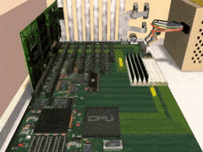
Govt. Polytechnic College, Jalandhar
Department of Computer Science &Engineering
Focus on basic elements of
computer programming,
hardware and networking.
Develop software applications.

Slide 13

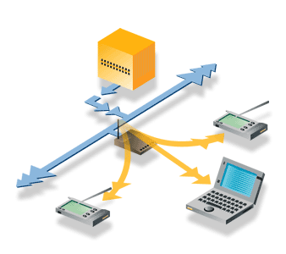
Department of Computer Science & Engineering

Slide 14
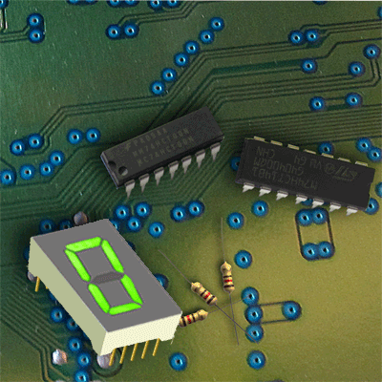
Govt. Polytechnic College, Jalandhar
Department of Electronics & Communication Engineering
Design electronic circuits,
Devices VLSI devices & their
systems.
Design and test electrical
components such as resistors,
Capacitors, diodes & transistors

Slide 15
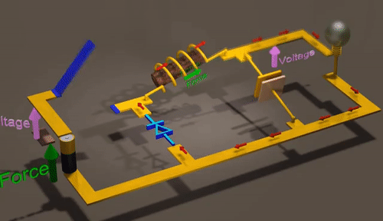
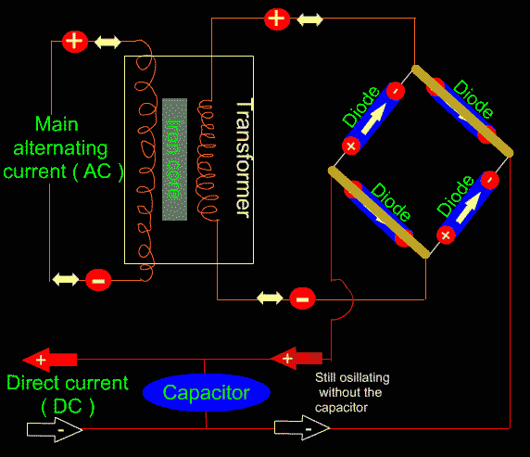
Department of Electronics & Communication Engineering

Slide 16
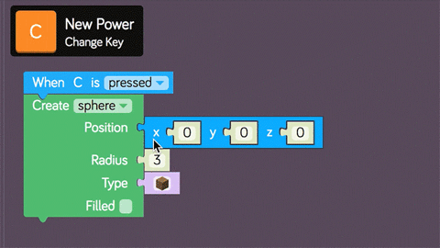
Govt. Polytechnic College, Jalandhar
Department of Information Technology
Unveil the power of click to enter
the World of Knowledge.
Latest trends in software design
and web development.
Programming languages
Online services, e-commerce.

Slide 17
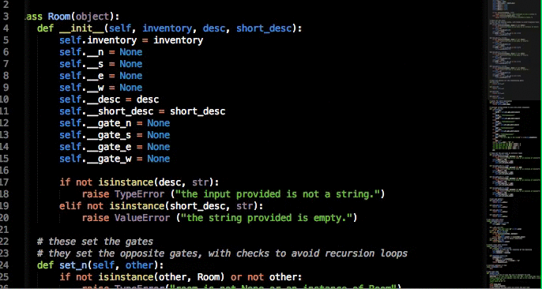

Govt. Polytechnic College, Jalandhar
Department of Information Technology

Slide 18
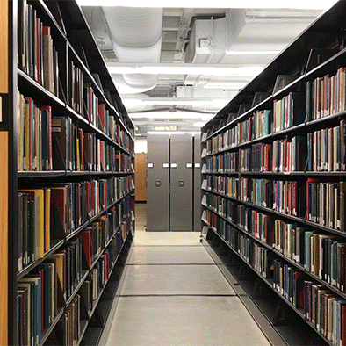
Govt. Polytechnic College, Jalandhar
Department of Library & Information Science
Deals with collecting, preserving
and organizing books and other
materials in libraries.
Involves classification, cataloguing,
storing and retrieving
information.

Slide 19

Govt. Polytechnic College, Jalandhar
Department of Modern Office Practice
Enable students to perform various
operations and procedures with the
help of modern methods and
equipments.
Impart abilities and skills to cope up
with the era of information technology.

Slide 20
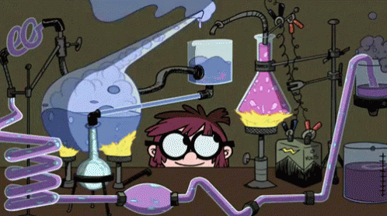
Govt. Polytechnic College, Jalandhar
Department of Pharmacy
Involves compounding, dispensing,
clinical testing of drugs and cosmetics.
After completion of diploma,
student is registered as
Pharmacist in DHS.

Slide 21
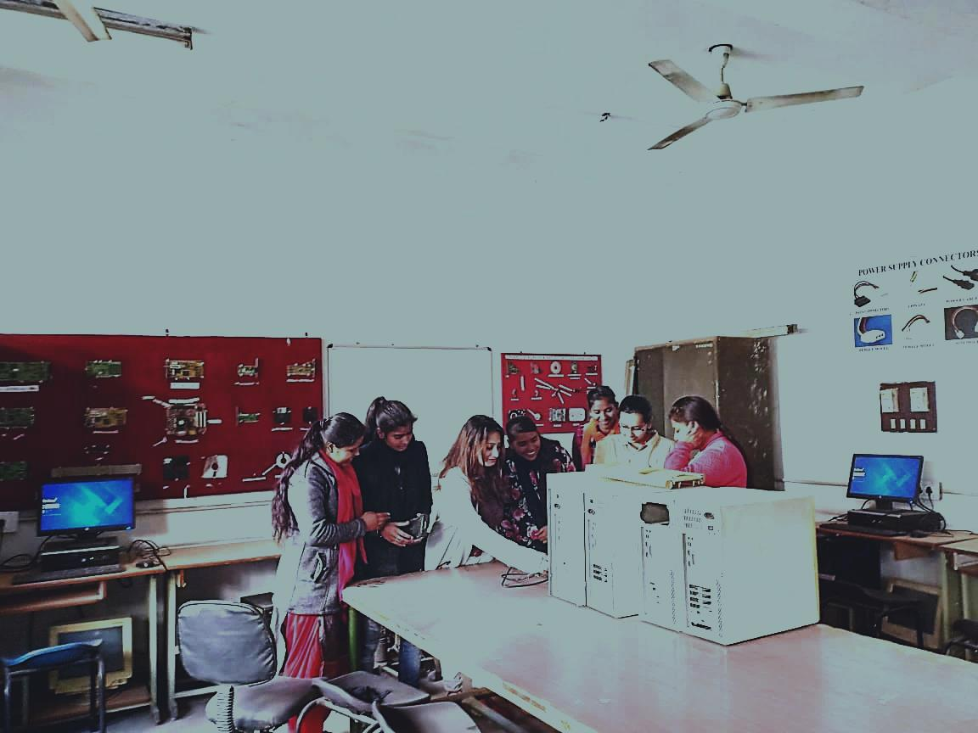
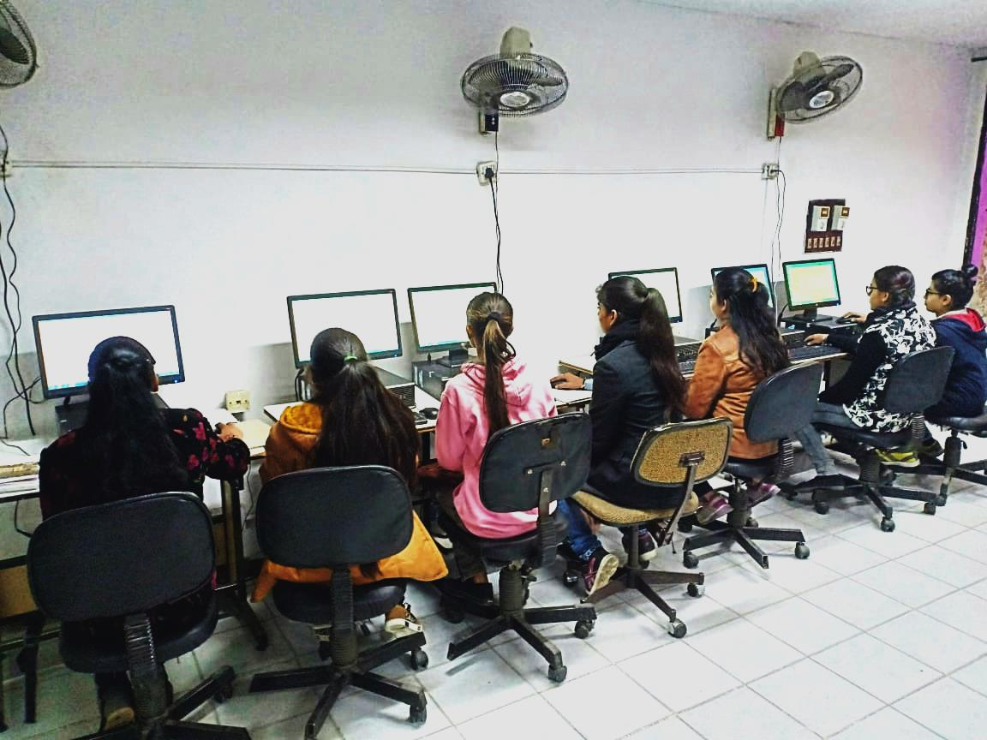
Laboratories

Slide 22
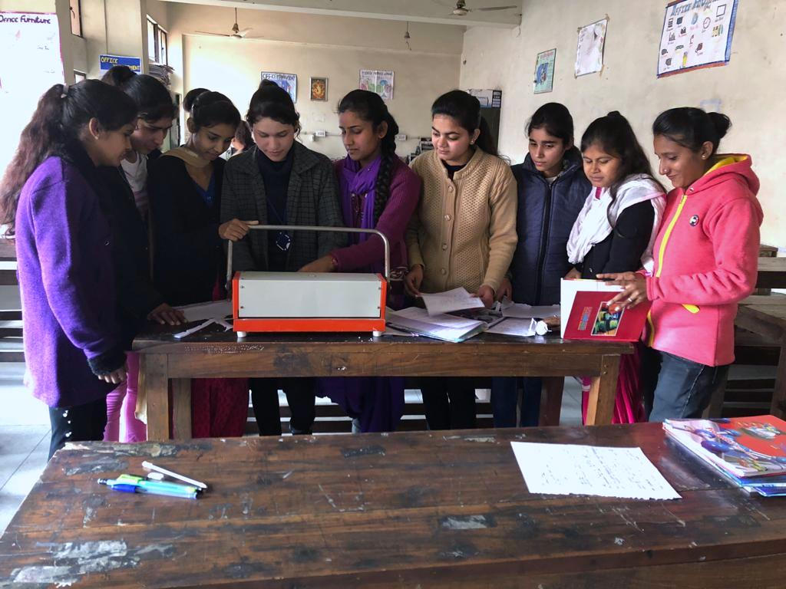
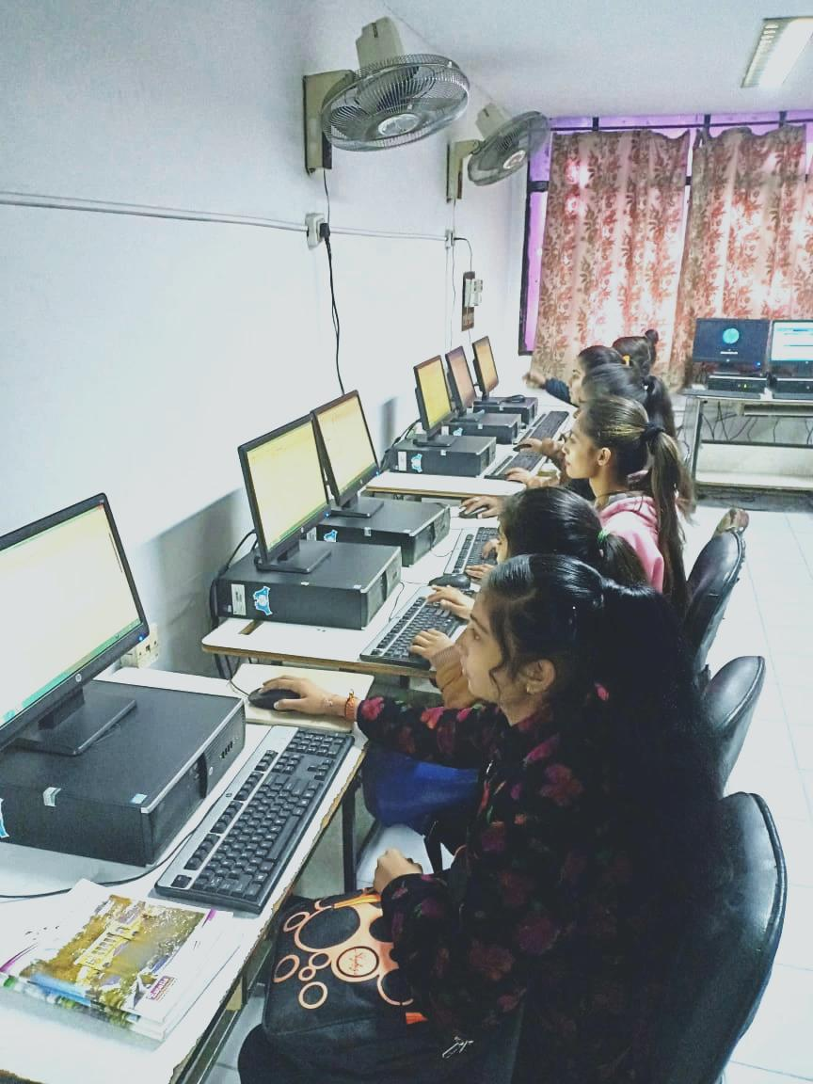
Laboratories

Slide 23
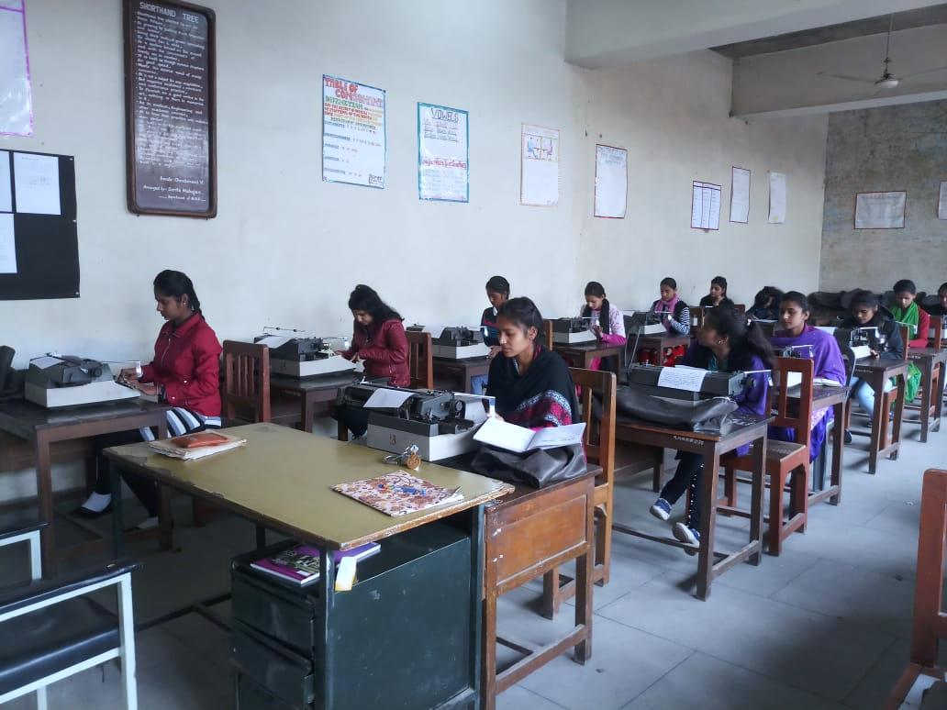
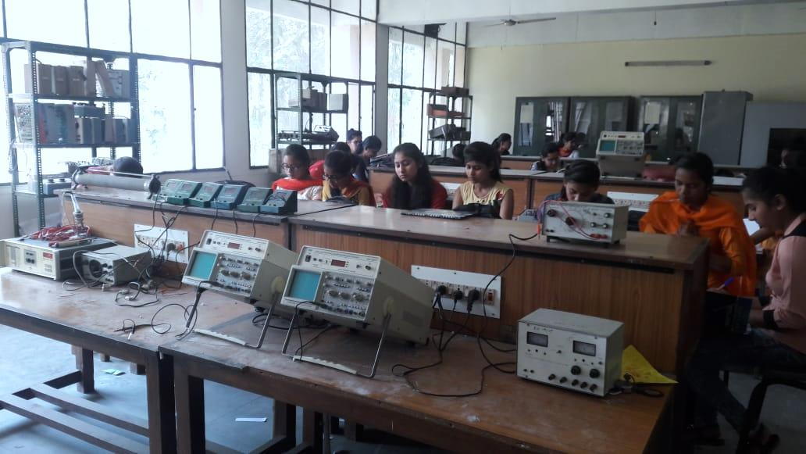
Laboratories

Slide 24
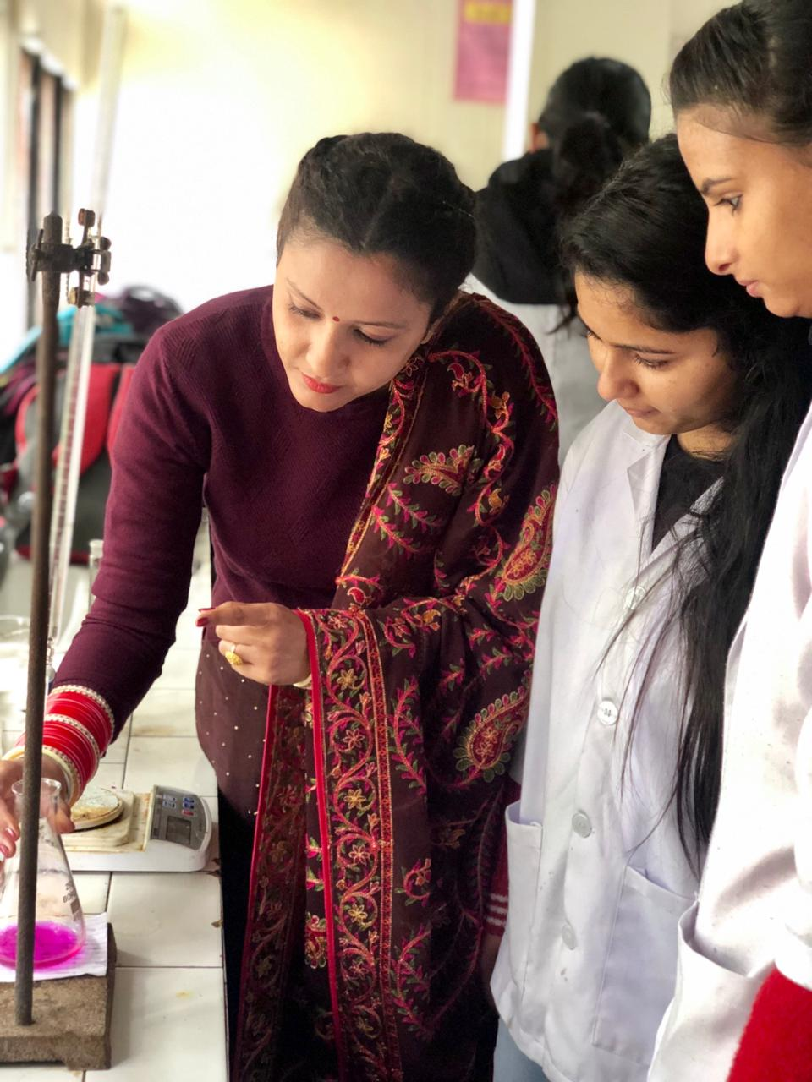
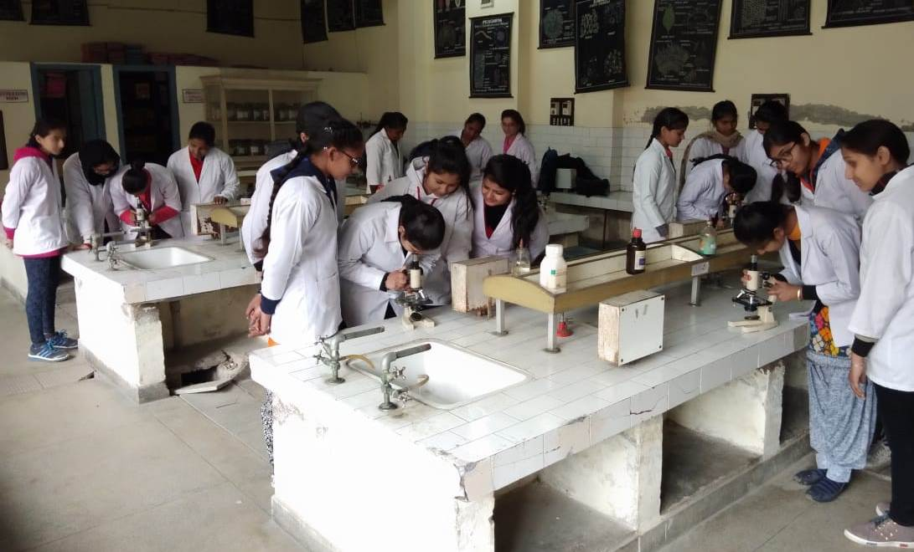
Laboratories

Slide 25
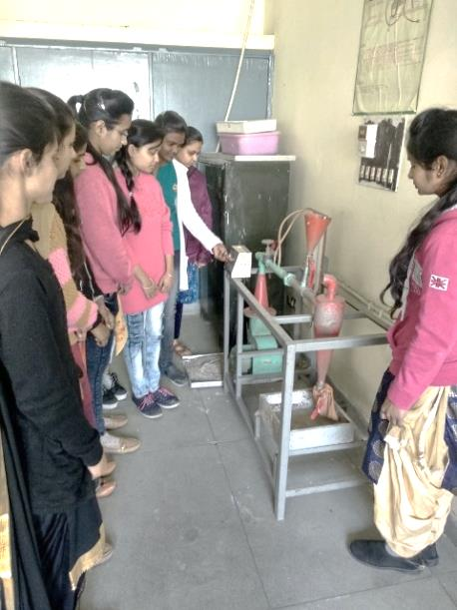
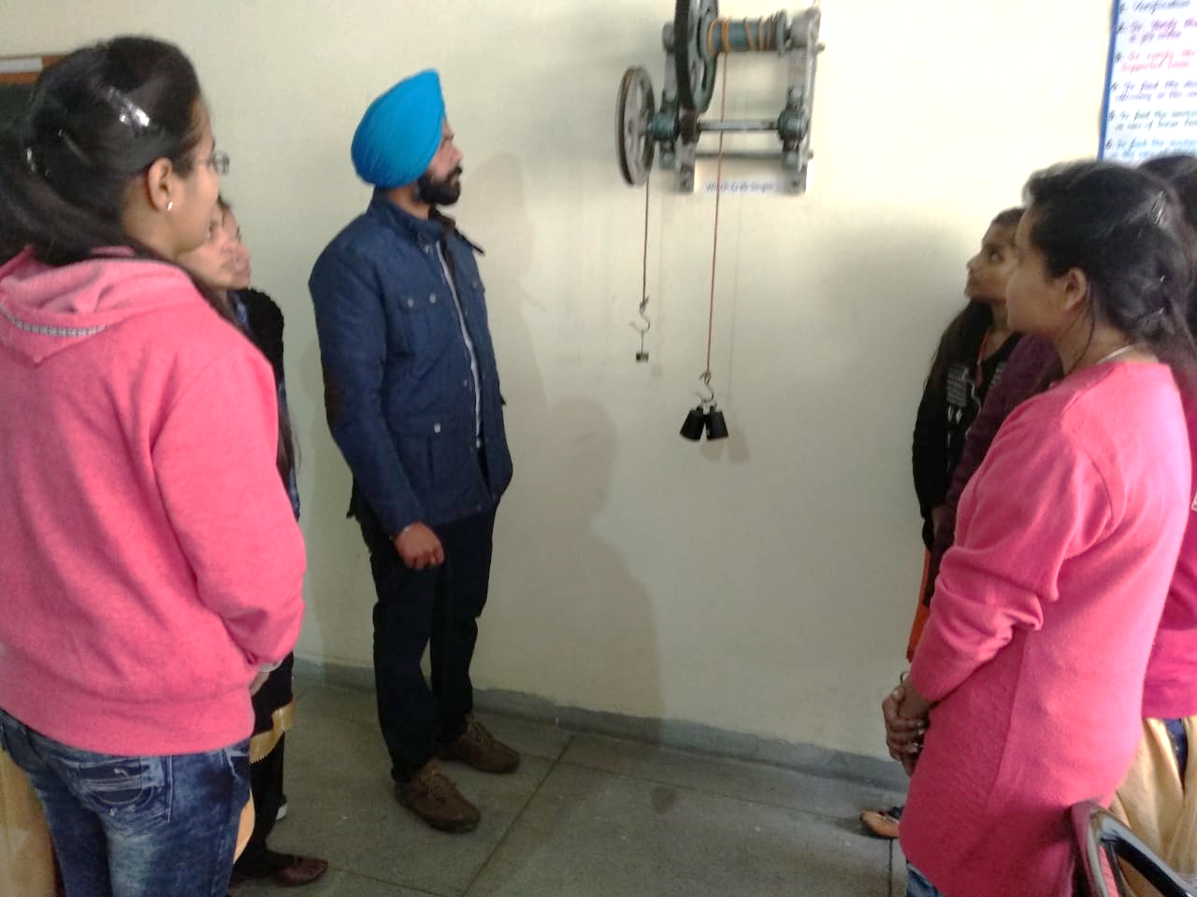
Laboratories

Slide 26
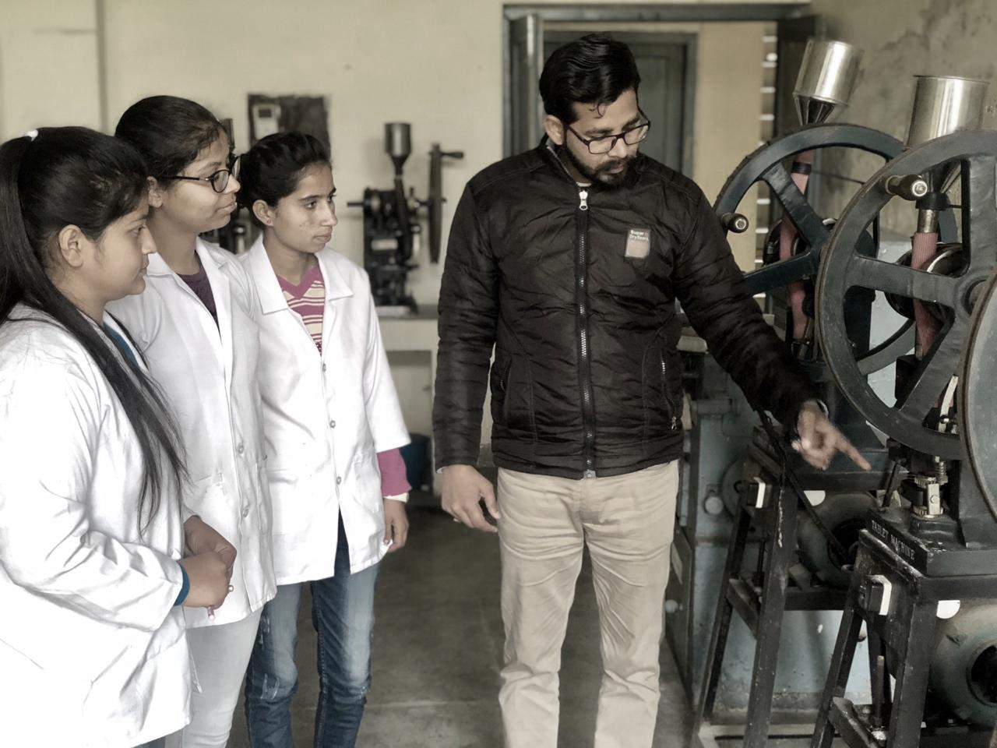
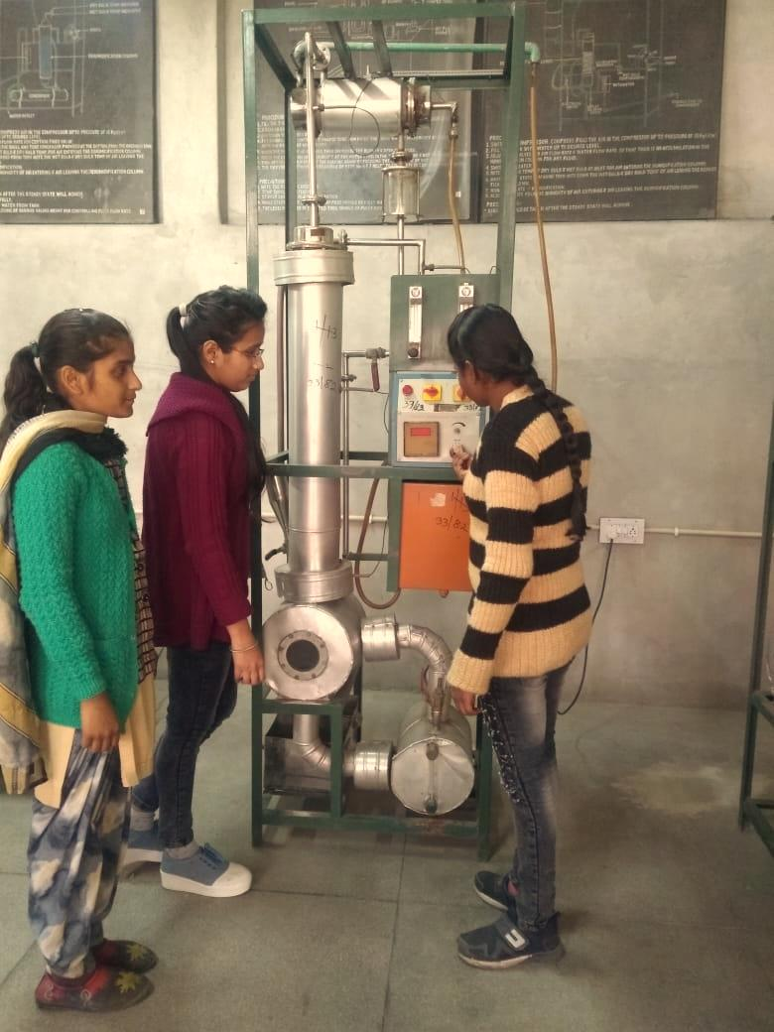
Laboratories

Slide 27




Clubs
Apart from providing technical skills, we emphasize on overall personality development of students.
To achieve this goal college has created number of clubs.
LITERARY
CLUB
NSS
Environment
club
SPORTS
CLUB

Slide 28
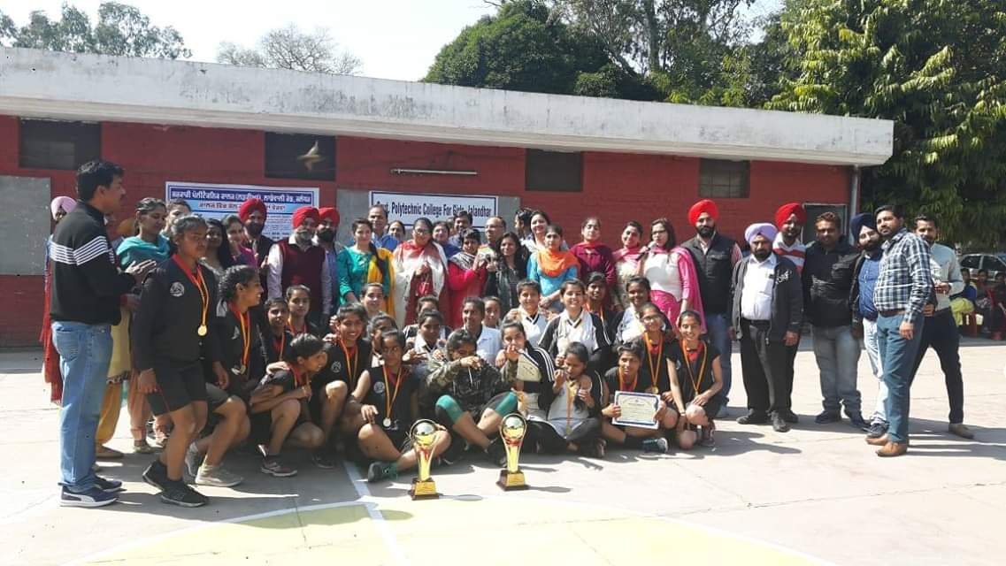
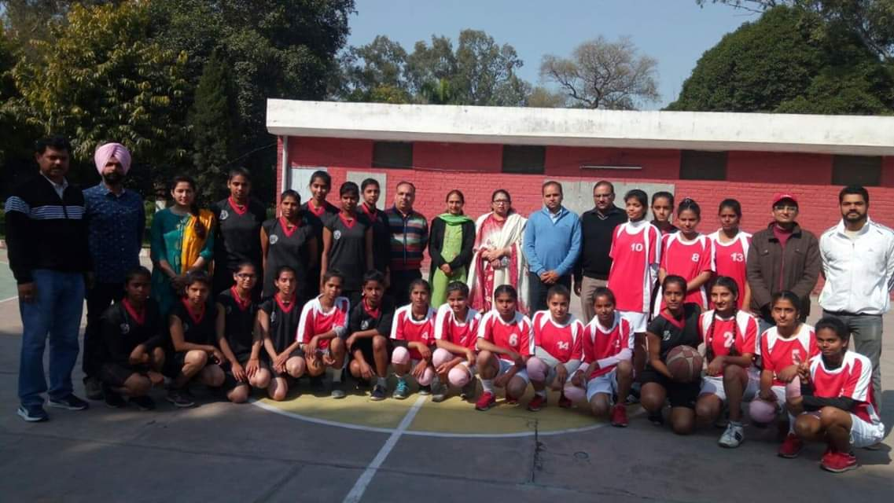
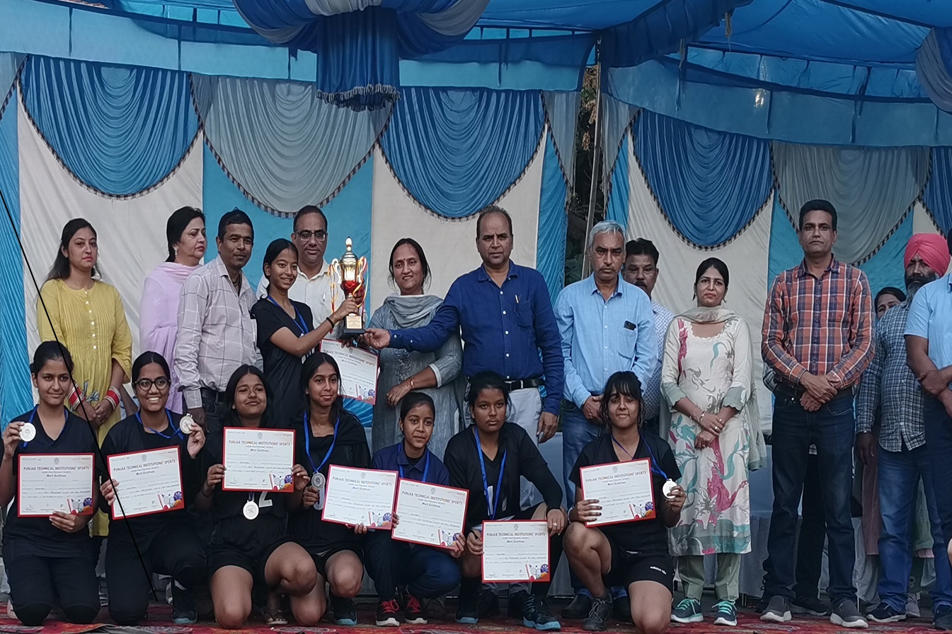
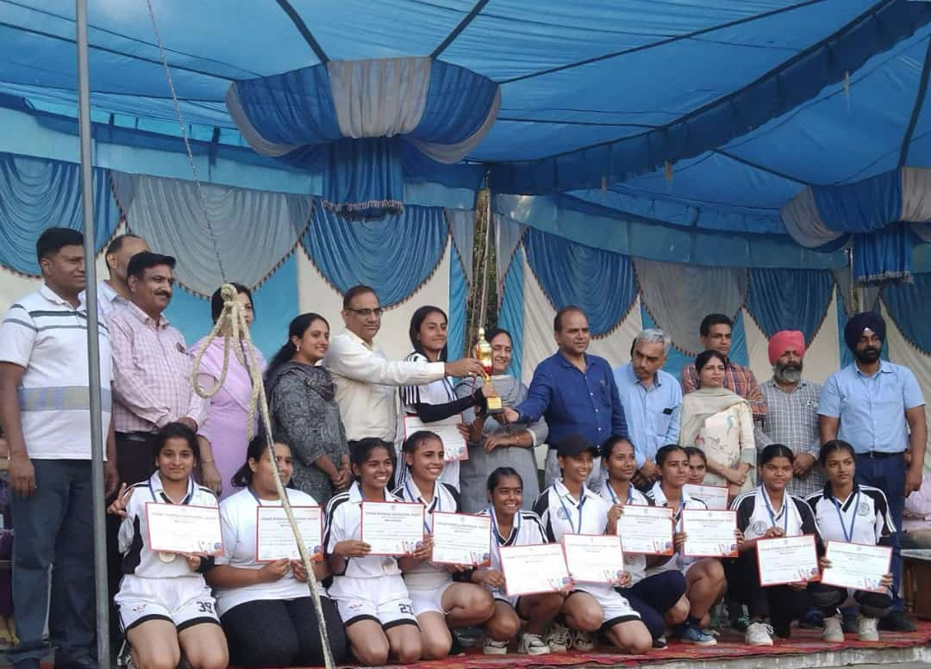
Activities by Sports Club
Medals in PTIS Games

Slide 29
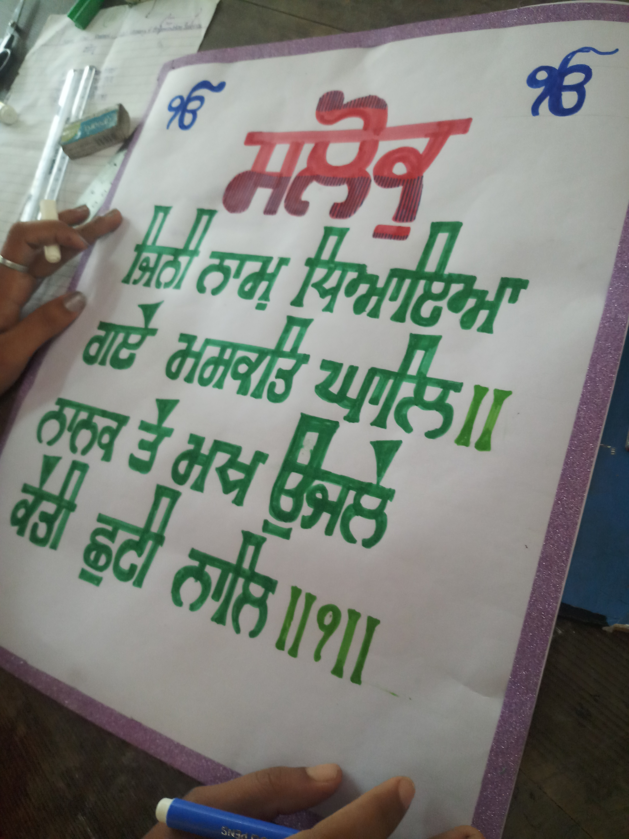
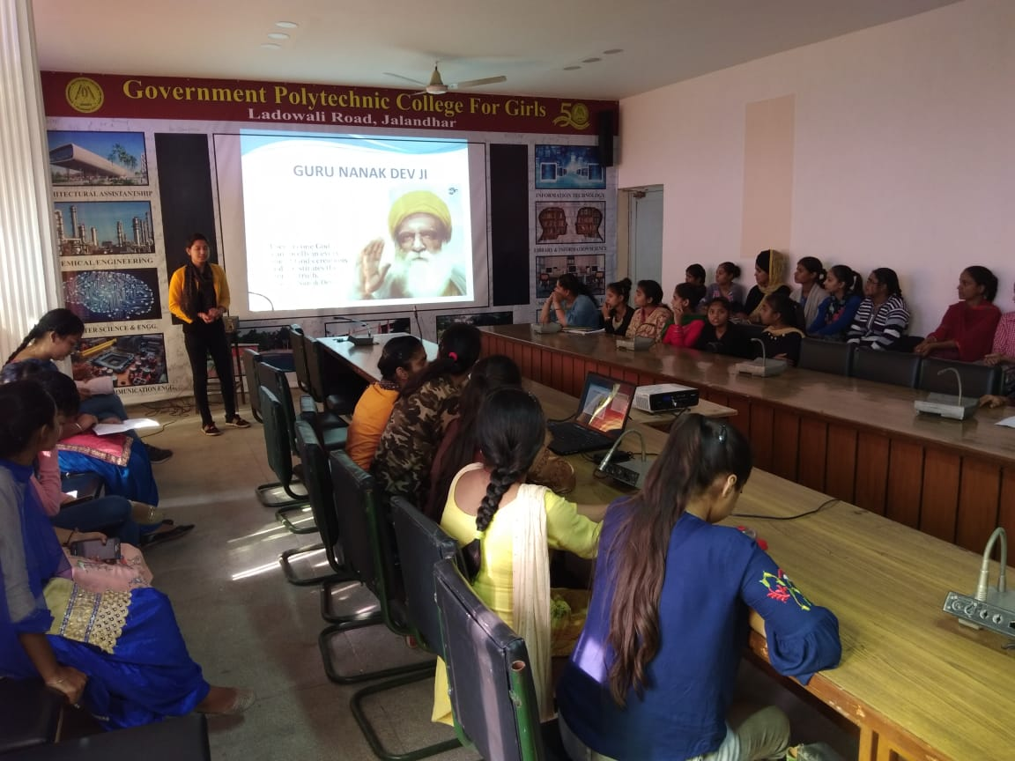
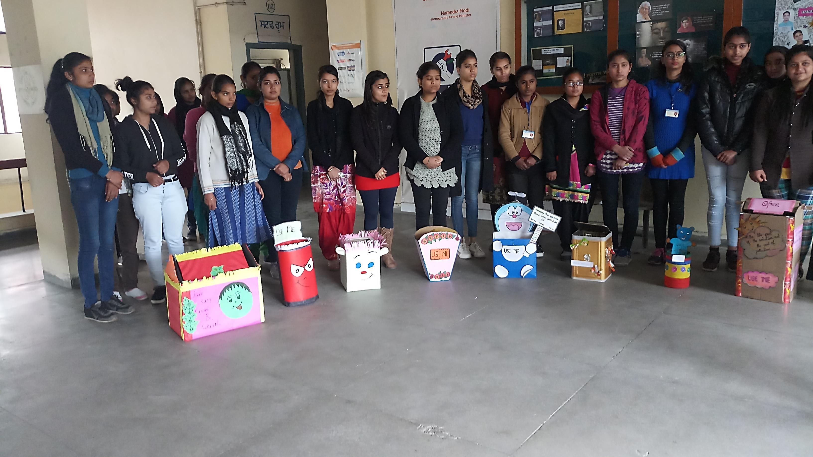
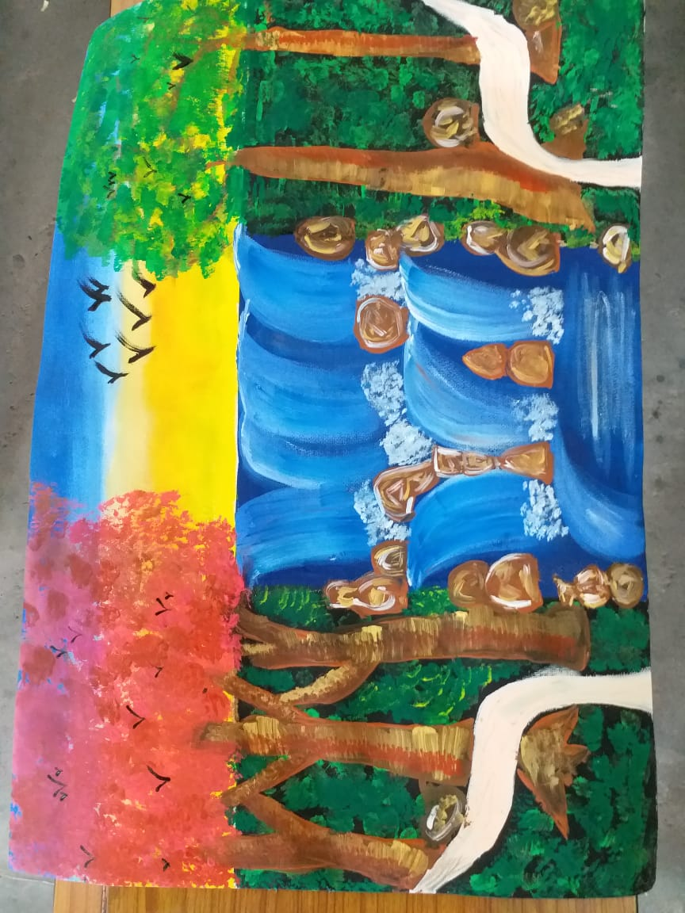
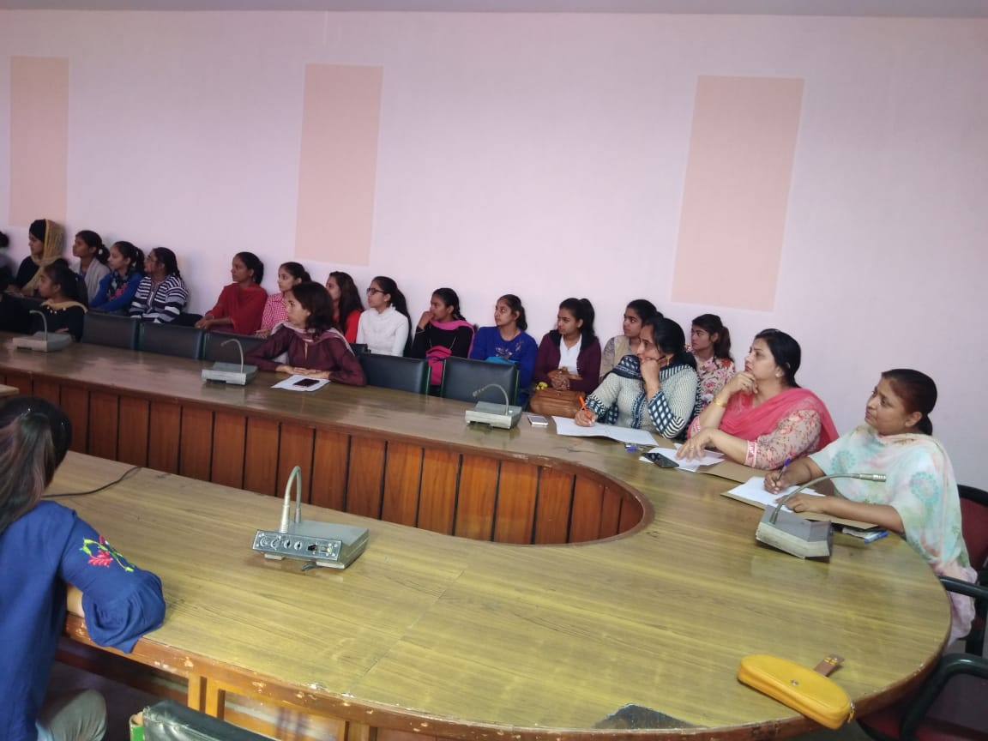
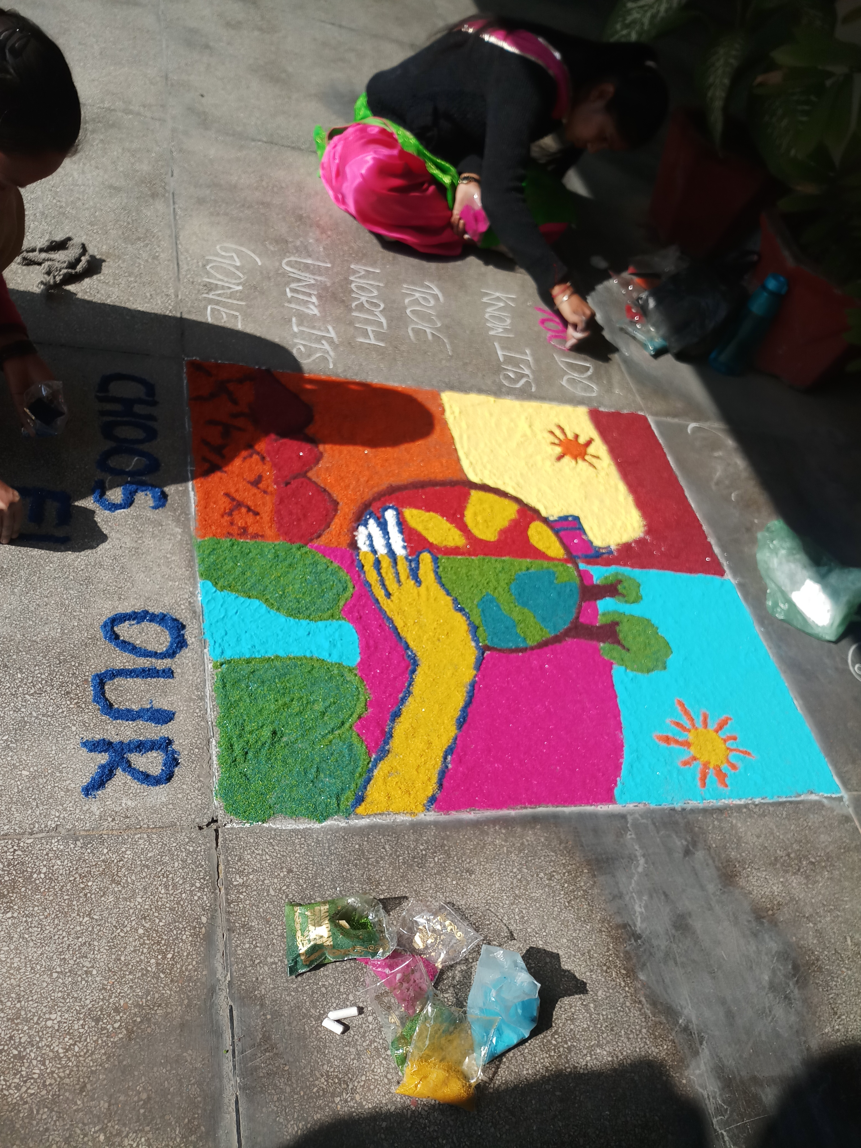
Activities by Literary Club

Slide 30
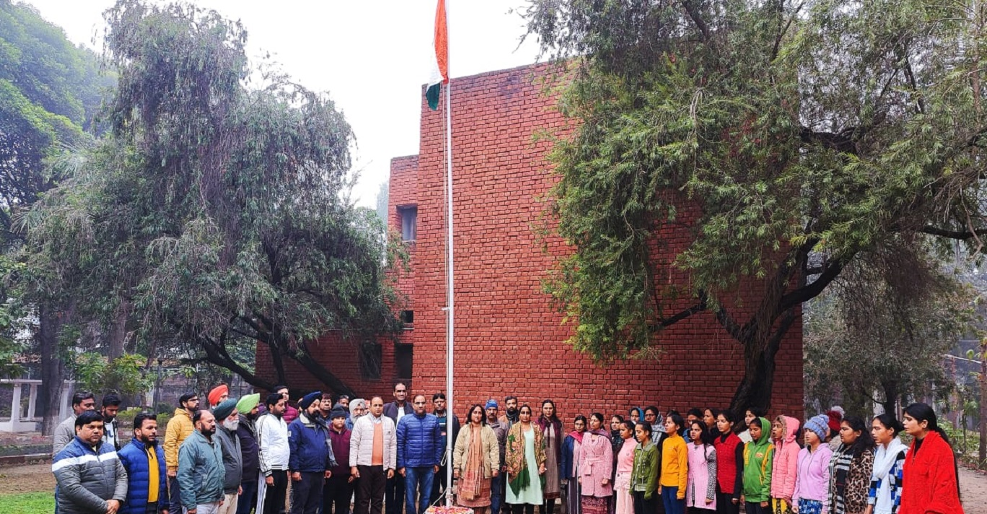
Republic Day Celebrations

Slide 31
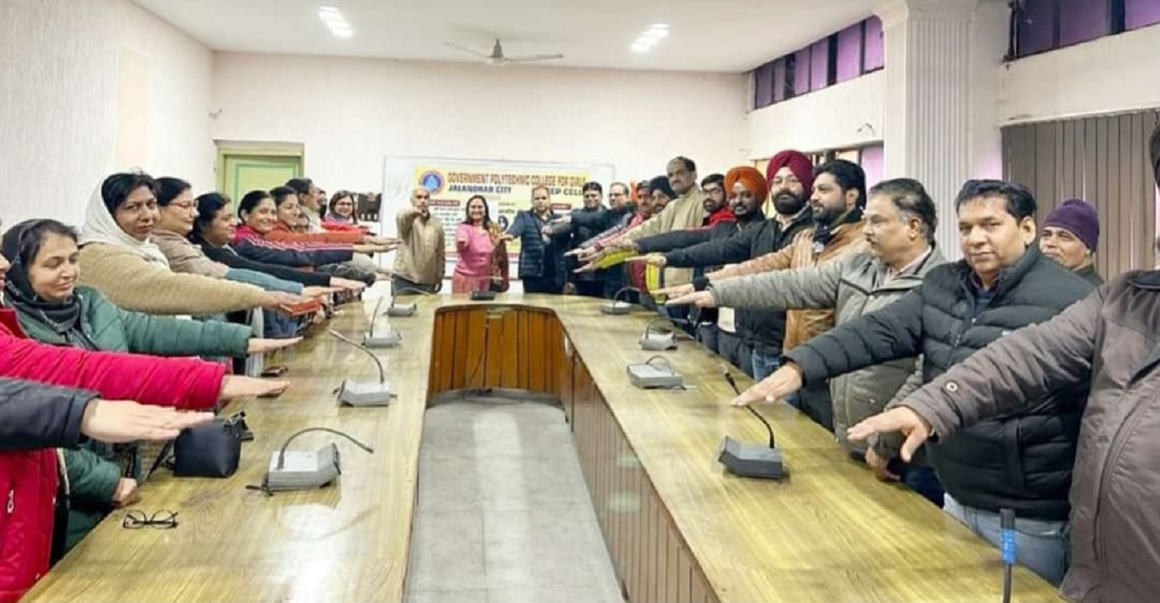
Constitution Day Celebration

Slide 32
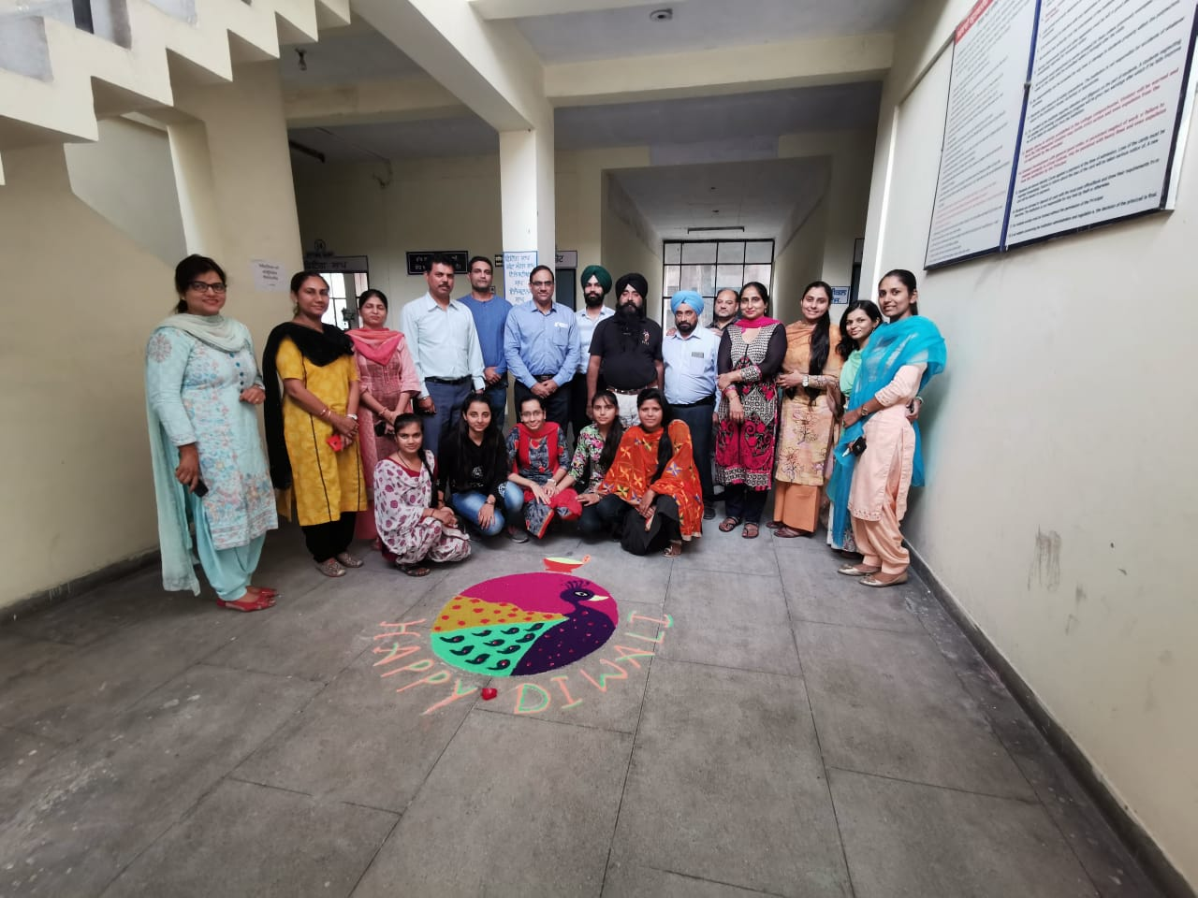
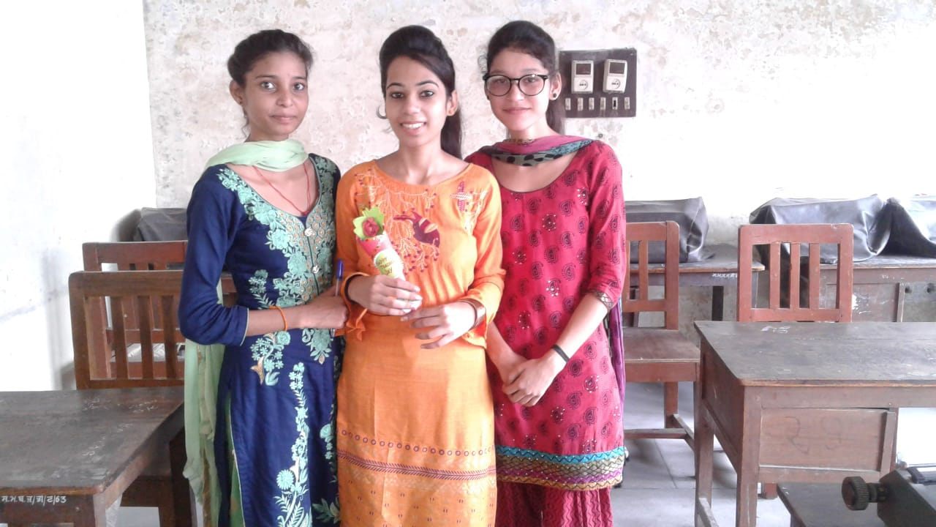
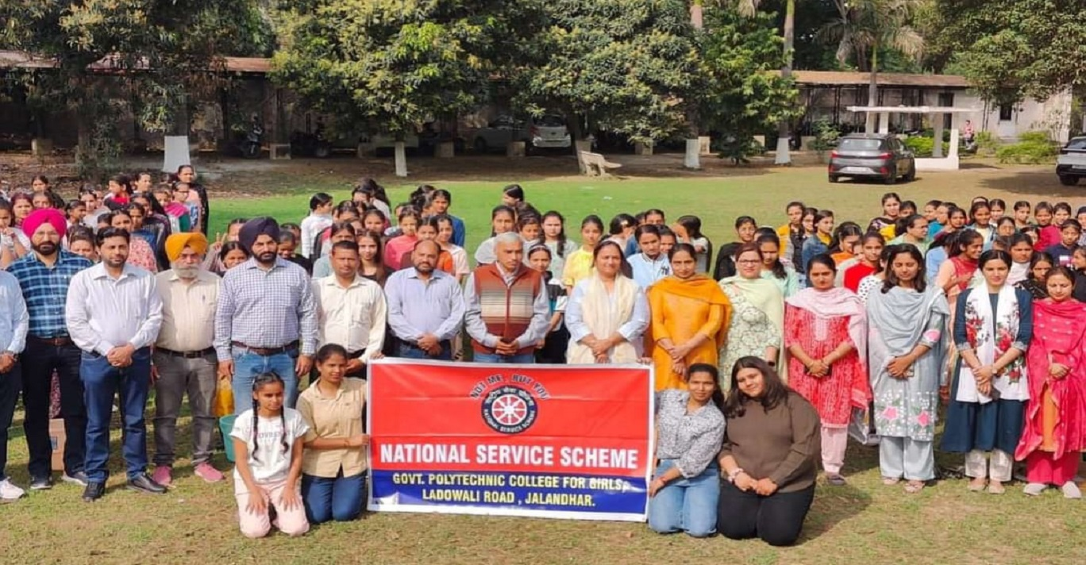
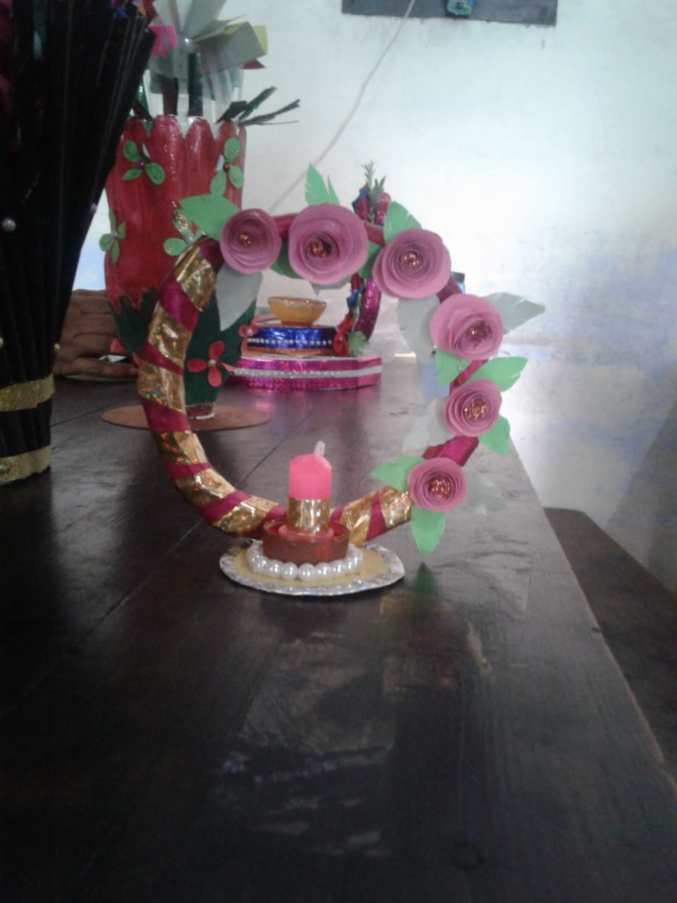
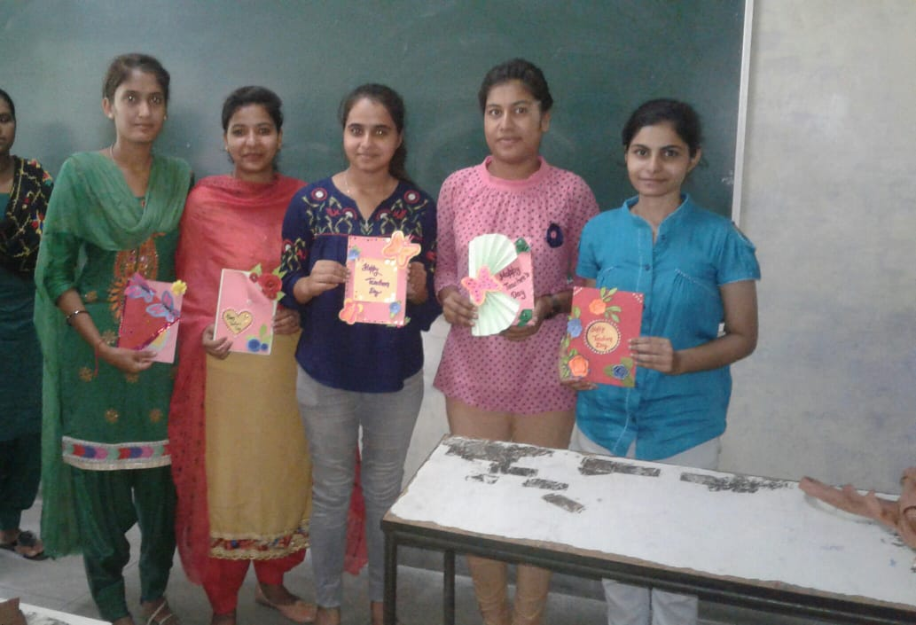
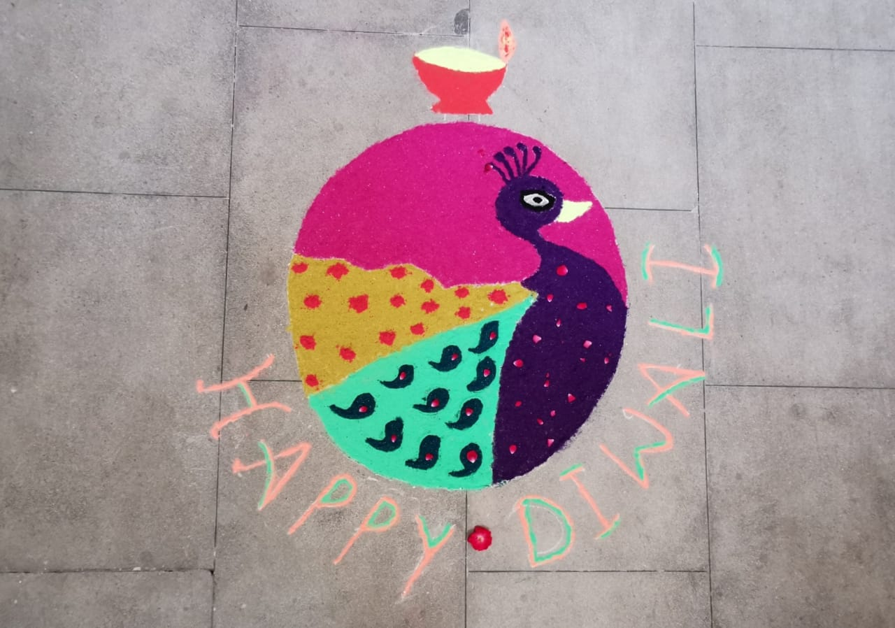
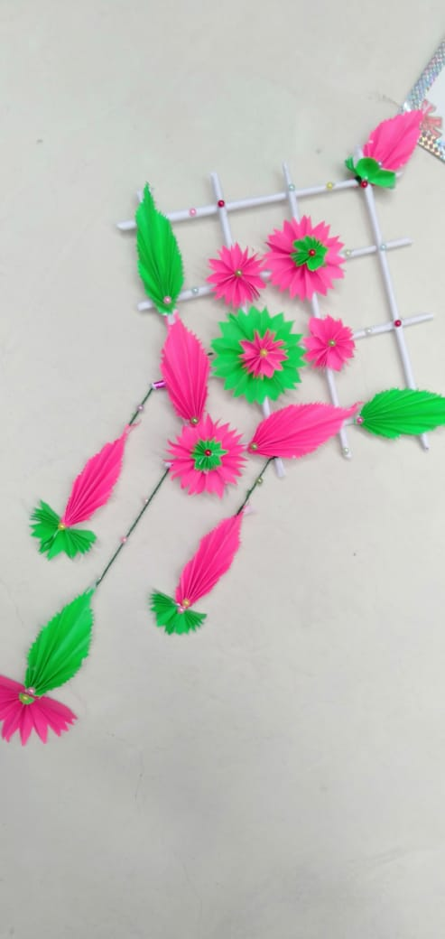
Extra Curricular Activities

Slide 33
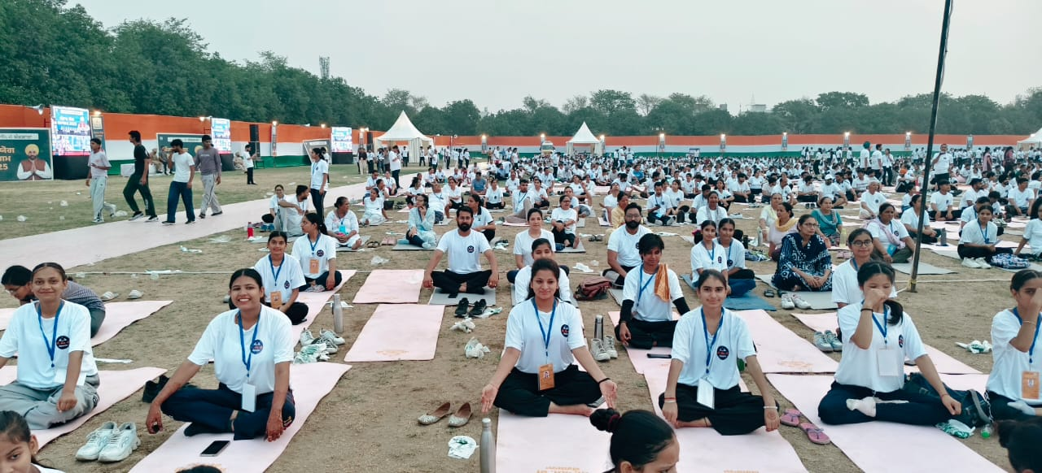
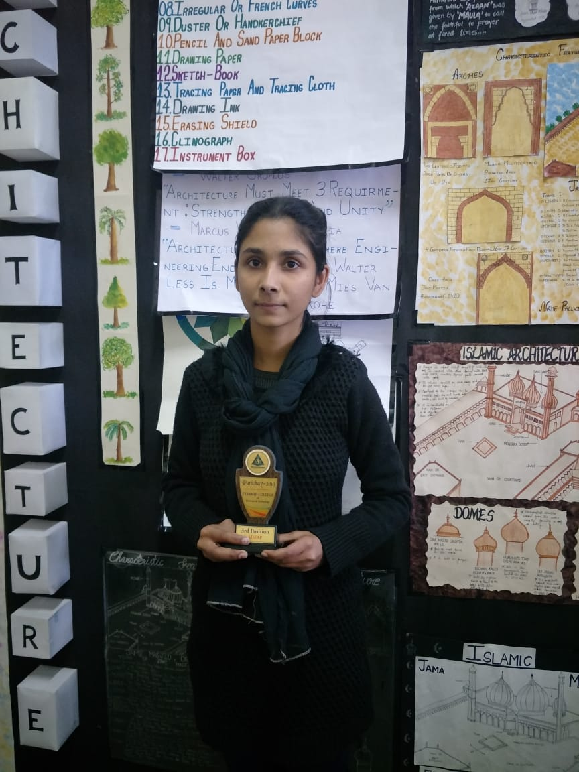
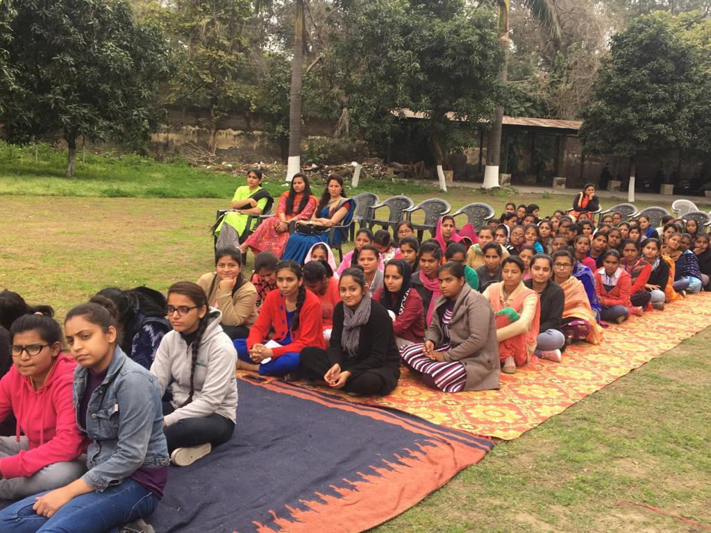
Extra Curricular Activities
International Women’s Day Celebration
International Yoga Day Celebration
Poster Making Winner

Slide 34
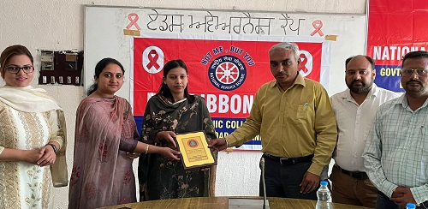
Extra Curricular Activities
Students in NSS Camp

Slide 35
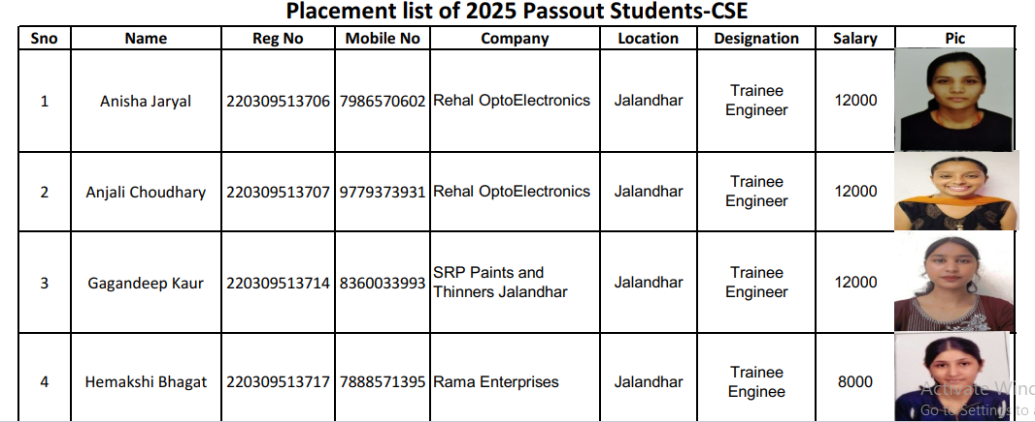
Top Placements

Slide 36

Placements

Slide 37

Placements

Slide 38

Placements

Slide 39

Placements

Slide 40

Govt. Polytechnic College, Jalandhar

